Slide 1
Demand Measurement Tools
Steven Suranovic
George Washington University

Slide 2
Demand Measurement Tools
Elasticities – measures the sensitivity of demand to changes in key variables such as prices and income
Consumer Surplus – measures the amount of surplus value that accrues to all consumers of a product in a market (measures consumer happiness)

Slide 3
Price Elasticity of Demand
Slope of demand curve measures sensitivity
Measures how the quantity changes given changes in price
But, not comparable across different quantity units (eg. can’t compare sensitivity of steel and soybeans)
Elasticities use percentage changes in prices and demand
Makes them comparable across products

Slide 4
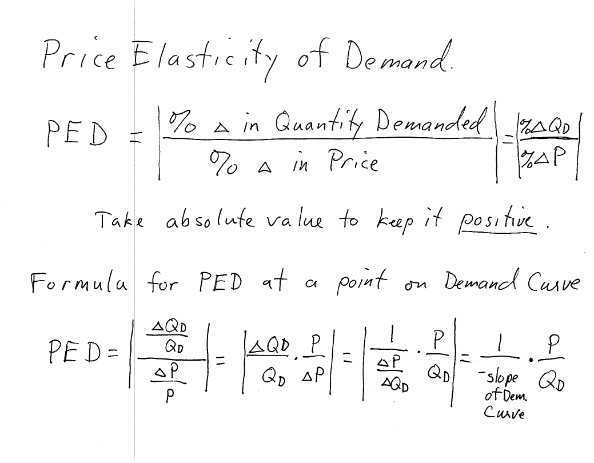

Slide 5
Price Elasticity of Demand
If PED > 1 we say demand is elastic (sensitive)
If PED < 1 we say demand is inelastic (insensitive)
If PED = 1 we say demand is unit-elastic
If PED = 0 we say demand is perfectly inelastic
If PED = ∞ we say demand is perfectly elastic

Slide 10
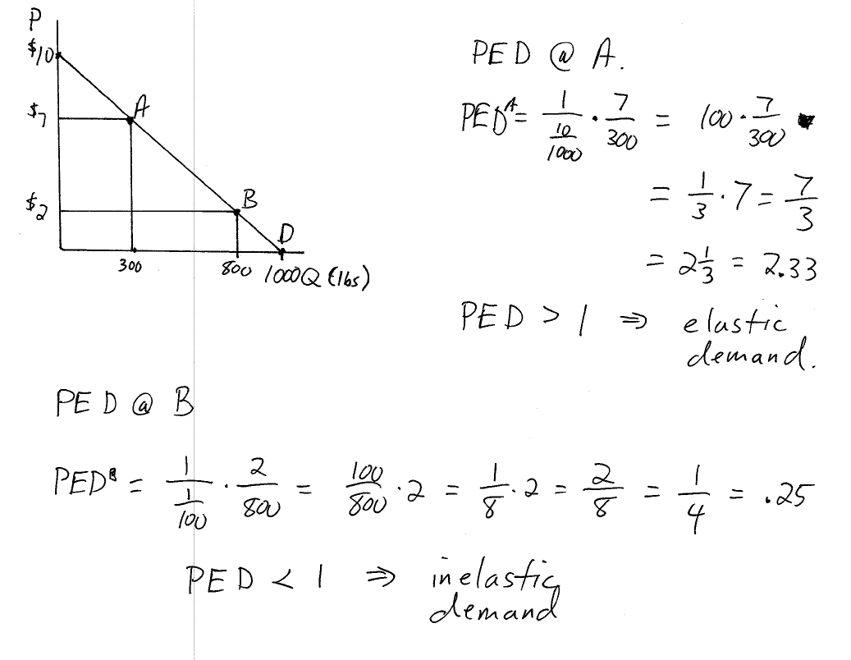

Slide 14
Price Elasticity of Demand
For a Linear Demand curve,
PED decreases as one moves down to the right along demand curve
PED is unit-elastic at the demand midpoint

Slide 15
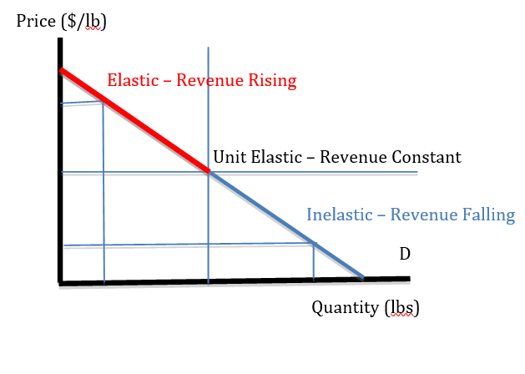
Price Elasticity of Linear Demand
Red segment - elastic
Blue segment – inelastic
Midpoint – Unit-elastic
Revenue = PxQ
Rectangular area under demand
Revenue rises along red
Revenue falls along blue

Slide 16
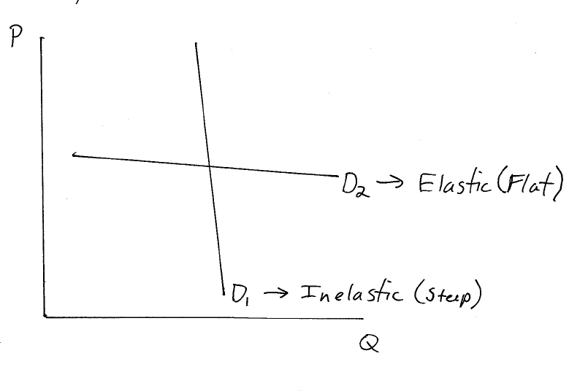
Price Elasticity of Demand
In General,

Slide 17
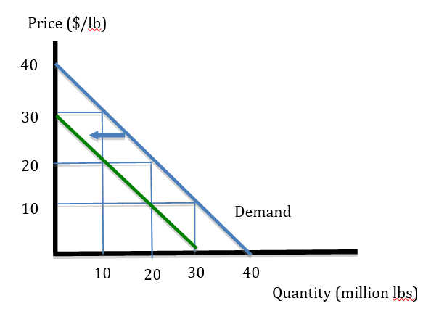
Price Elasticity of Demand Exercises
Calculate PED at P = 30 (blue demand)
Calculate PED at P = 20 (blue demand)
Calculate PED at P = 20 (green demand)
Calculate Revenue at P = 30 (blue demand)
Calculate revenue at P = 10 (green demand)

Slide 18
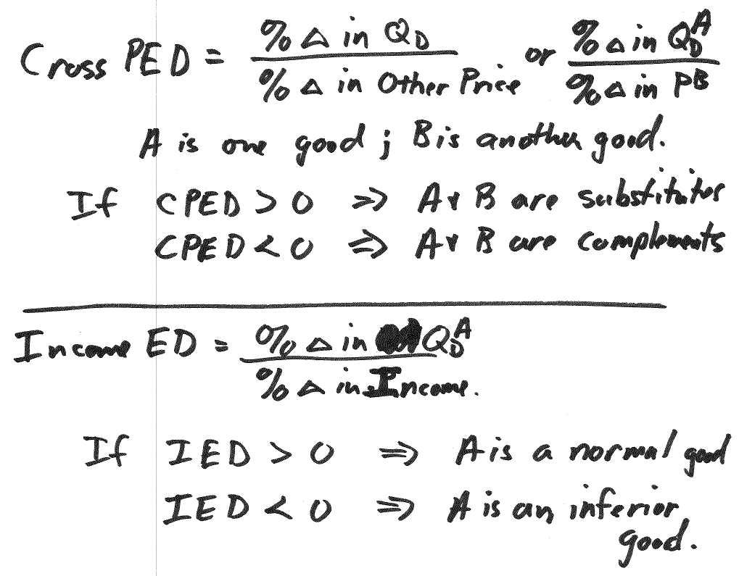
Other Elasticities

Slide 19
Consumer Surplus
Uses information from the demand curve to measure the aggregate amount of surplus value accruing to all purchasers of a product.
Provides a dollar value corresponding to the increase in utils obtained when trade occurs.
Surplus is added up across all consumers in the market, rather than just one trade as between Smith and Jones

Slide 20
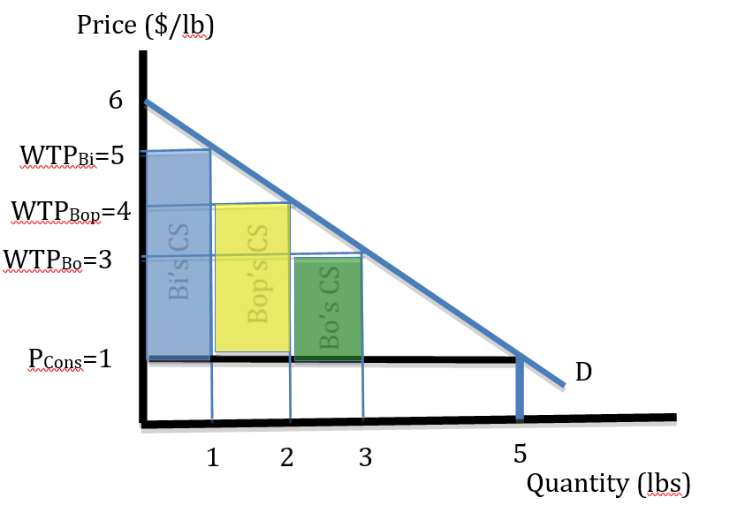
Consumer Surplus
WTP = willingness to pay
Suppose the market price is $1
Bi’s WTP = $5, but only pays $1 → $4 surplus
Bop’s WTP = $4, but only pays $1 → $3 surplus
Bo’s WTP = $3, but only pays $1 → $2 surplus

Slide 21
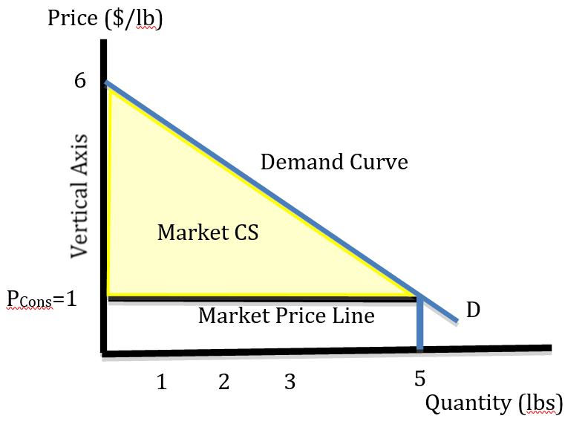
Consumer Surplus
Total market surplus found by adding up the individual surpluses
Approximated as area between
the demand curve
the market price line
The vertical (price) axis
CS = ½(6 – 1)(5) = $12.5

Slide 22
Consumer Surplus
Total revenue = PxQ
= 1(5) = $5
If a person’s WTP = $1, that person is indifferent between buying this good or buying something else, thus this $ value is analogous to the utility of the next best opportunity
CS then, is the “extra utility” generated by trade.

Slide 23
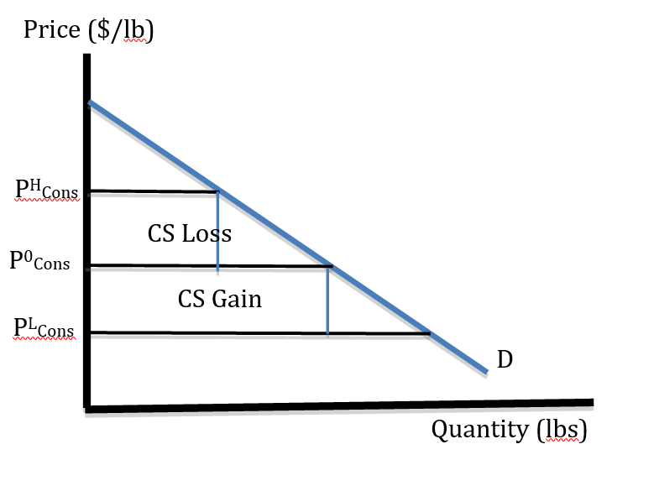
Changes in Consumer Surplus
We will often want to measure how surplus changes in different scenarios
ΔCS is the area between
The original price line (P0)
The new price line (PL or PH)
The demand curve
The vertical (price) axis
Taking note of +/- sign

